Slide 1
From Rack to Sinatra

Slide 2
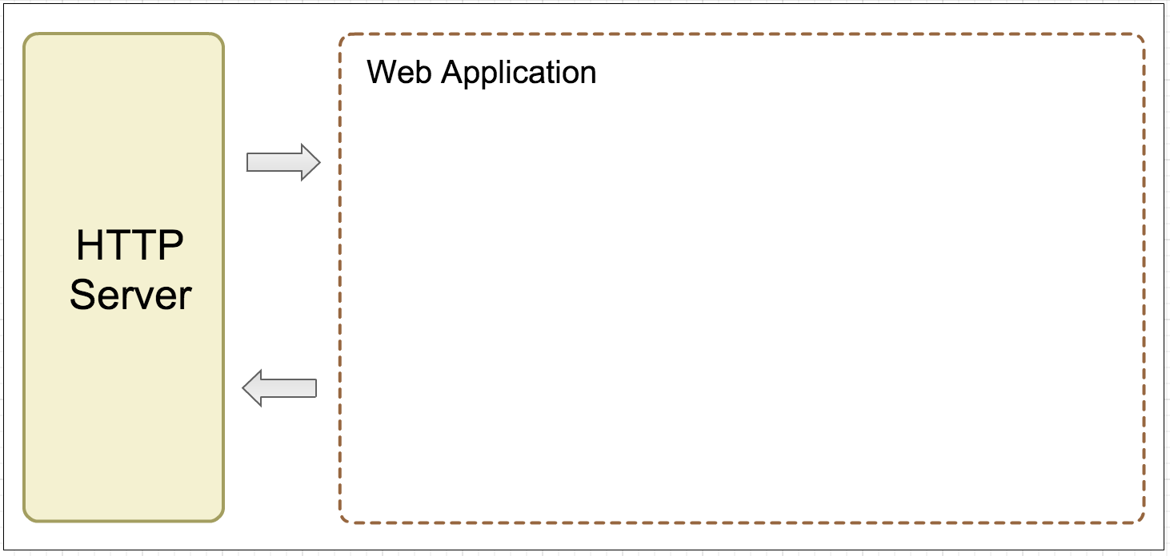
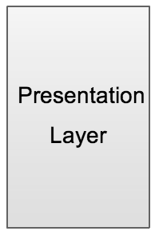
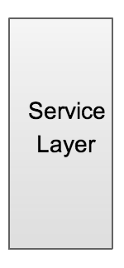
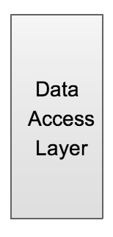
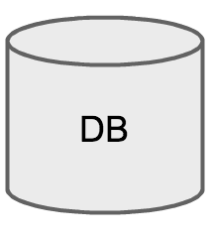

WHAT THE HELL IS THIS?

Slide 3
HTTP Server
Notes:
A HttpServer is bound to an IP address and port number and listens for incoming TCP connections from clients on this address.

Slide 4
A process running at a server which sends out HTTP response to HTTP requests from a certain PORT.

Slide 5
What exactly does HTTP Server managing?

Slide 6
Web Resource

Slide 7
Image Document Web page JS CSS

Slide 8
How ?

Slide 9
URI/URL Uniform Resource Identifier/Locator

Slide 10
Key Conceptions HTTP Request, HTTP Response, URI, Port

Slide 11
So, as a Web App developer, what should we do?
Notes:
Register to a http server, handling http request, send http response back.

Slide 12
Rack A interface between http server and web app in Ruby world

Slide 13
Example Connecting to HTTP Server
Notes:
Start, port

Slide 14
Example Handling HTTP Request and Response – Rack env

Slide 15
Example URL Mapping – env & Request
Notes:
URI & URL

Slide 16
Example HTTP Methods
Notes:
Query
post

Slide 17
Example Static File
Notes:
URI & URL

Slide 18
Example Rack Middleware: mapping, http methods, static
Notes:
Query
post

Slide 19
But …
Notes:
Query
post

Slide 20
Simplicity

Slide 21
Sinatra

Slide 22
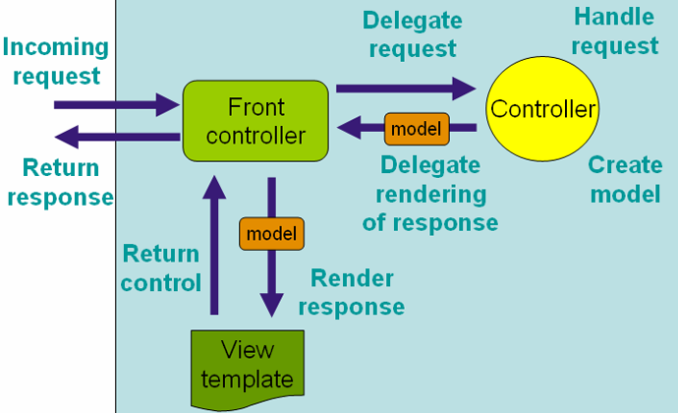

Slide 23
END

